Slide 1
Big Data and NoSQL
Assylbek Almaganbetov
Aibek Aldabergenov

Slide 2
“BIG” DATA
Any collection of large and complex data sets that are difficult to process.
“Nowadays, it may mean data that is too large to be placed in a relational database and… requires massively parallel software running on tens, hundreds, or even thousands of servers.” (Jacobs, A. 2009)

Slide 3
Who has Big data?
Governments
Intelligence agencies
Estimated capacity of NSA Data Center in Utah is 3-12 EB = 3-12 million terabytes (2013)
Science and Research
Private Sector
Ebay.com had nearly 90 PB of customer data in 2013

Slide 4
RDBMS and Big Data
The problem is NOT
efficient transaction processing
storing some 6,750,000-row 10-column table (getting the data in)
updating, searching, retrieving small information in it
The problem IS
Analyzing (getting the data out)
Having the answers in seconds or minutes

Slide 5
Big Data Characteristics
Usually has some trend/correlation
Usually repeated observations over time
The number of distinct elements in a set tends to be much smaller than the total number of elements
“What happened?” “Why did it happen?” “What’s going to happen next?”

Slide 6
Big Data != Data Mining
Analytic process designed to explore data (big data) in search of consistent patterns between variables, and then to validate the findings by applying the detected patterns to new subsets of data.
The ultimate goal of data mining is prediction.

Slide 7
XML
eXtensible Markup Language
was designed to describe data
software- and hardware-independent tool for carrying information
uses tags and elements
XML Schema (W3C) - Specifies how to formally describe the elements in an XML document
Office Open XML (.docx, .xlsx, .pptx)

Slide 8
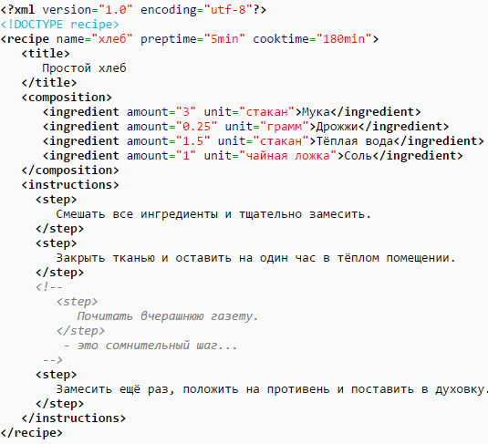
Parsing and Transporting Data

Slide 9
JSON
JavaScript Object Notation
language-independent
designed as an alternative to XML
often used with AJAX
Types: Number, String, Boolean, Array, Object, null
JSON Schema was created

Slide 10
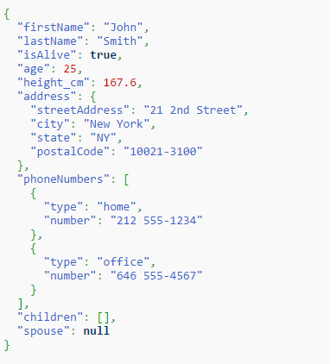
Parsing and Transporting Data

Slide 11
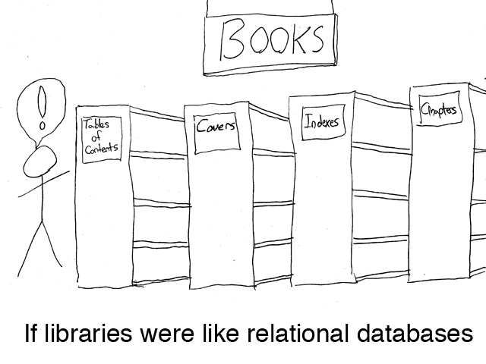
SQL

Slide 12
SQL Characteristics
Data stored in columns and tables
Relationships represented by data
Data Manipulation Language
Data Definition Language
Transactions

Slide 13
Transactions - ACID
Atomic – All of the work in a transaction completes (commit) or none of it completes
Consistent – A transaction transforms the database from one consistent state to another consistent state. Consistency is defined in terms of constraints.
Isolated – The results of any changes made during a transaction are not visible until the transaction has committed.
Durable – The results of a committed transaction survive failures

Slide 14
NoSQL
“A database administrator walks into a NoSQL bar,
but turns and leaves because she couldn't find a table.”

Slide 15
NoSQL (Not Only SQL)
Wide variety of different database technologies
Developed in response to a rise in the volume of data stored about users, objects and products, the frequency in which this data is accessed, and performance and processing needs.
Active development since 2008

Slide 16
NoSQL Characteristics
Not relational
Schema-less
Queries need to return answers quick
Mostly query – few updates
Asynchronous Inserts & Updates
Open-source

Slide 17
Transactions - BASE
Basically Available, Soft State, Eventually Consistent – Availability over Consistency
Weak consistency – stale data OK
Approximate answers - OK
Availability first
Best effort
Simpler and faster

Slide 18
Why NoSQL?
High-concurrency
Large volumes of structured, semi-structured, and unstructured data
Object-oriented programming
Low-cost hardware requirements (horizontal scaling with 1000s of computers)
In practice:
Do not need to be Google or have “big” data

Slide 19
NoSQL Types
Document databases pair each key with a complex data structure (document). Documents can contain many different key-value pairs, or key-array pairs, or even nested documents.
Graph stores are used to store information about networks, such as social connections.
Key-value stores are the simplest NoSQL databases. Every single item in the database is stored as an attribute name (or "key"), together with its value.
Wide-column stores are optimized for queries over large datasets, and store columns of data together, instead of rows.

Slide 20
Web Scale
Web-scale describes the tendency of modern architectures to grow at (far-)greater-than-linear rates.
Systems that claim to be Web-scale are able to handle rapid growth efficiently and not have bottlenecks that require re-architecting at critical moments

Slide 21
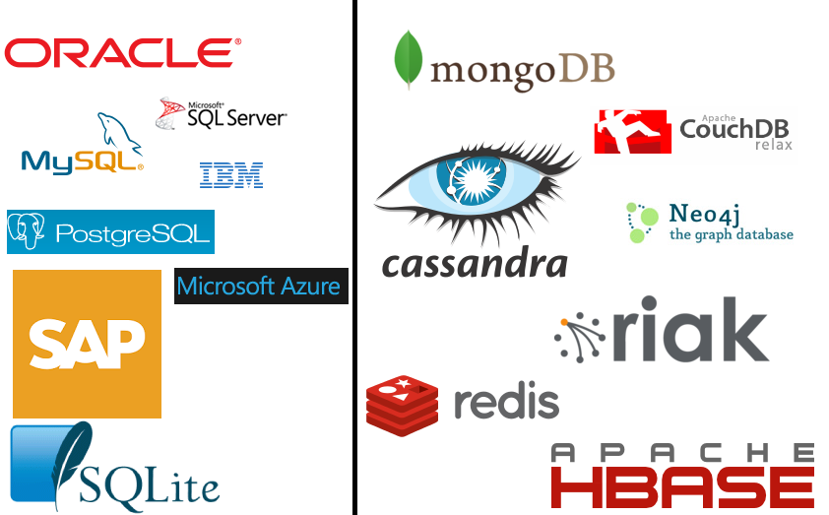
RDBMS NoSQL

Slide 22
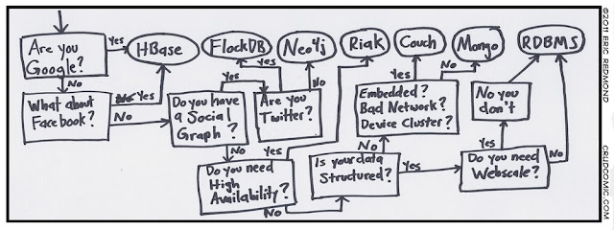
What to choose?

Slide 23
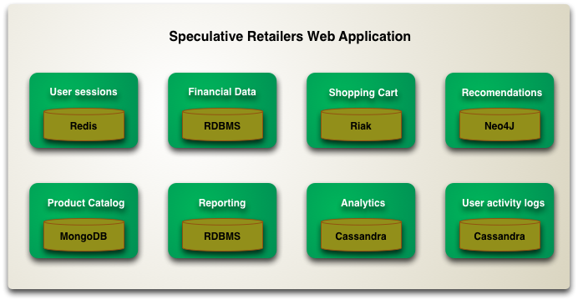
Using different DBs for different storage requirements

Slide 24
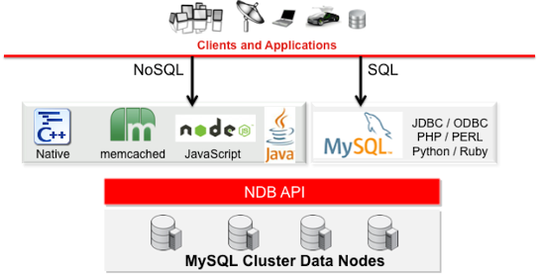
SQL and NoSQL API in MySQL

Slide 25
Limitations of NoSQL
Poor Customer Support
No single API
No predefined schema/Flexibility
Need to know OOP

Slide 26
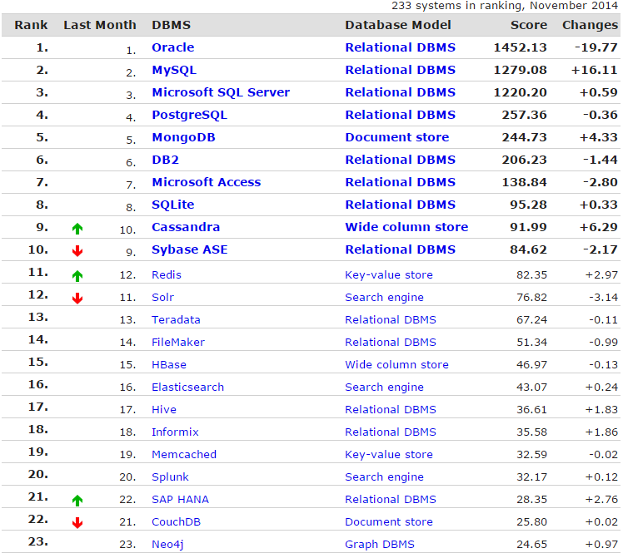

Slide 27

Document-oriented
Dynamic schema
Uses BSON (Binary JSON)
High performance, high availability, and automatic scaling
Open-source (created in 2009)

Slide 28
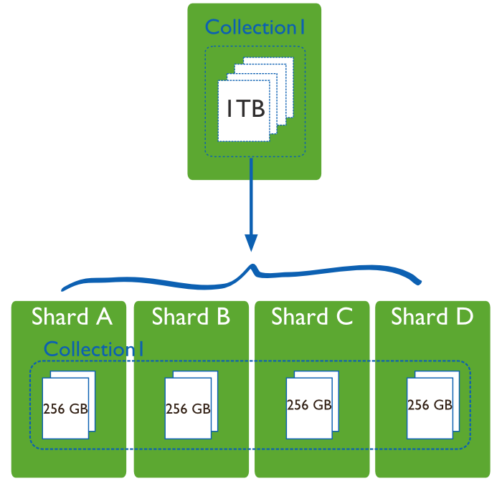
Horizontal Scaling (Sharding)
Each Shard is an independent DB
Together form one single logical DB

Slide 29
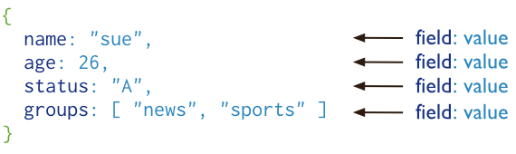
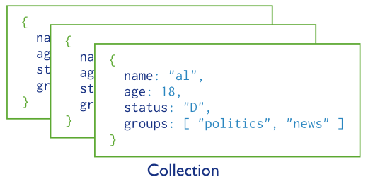
Document and Collection

Slide 30
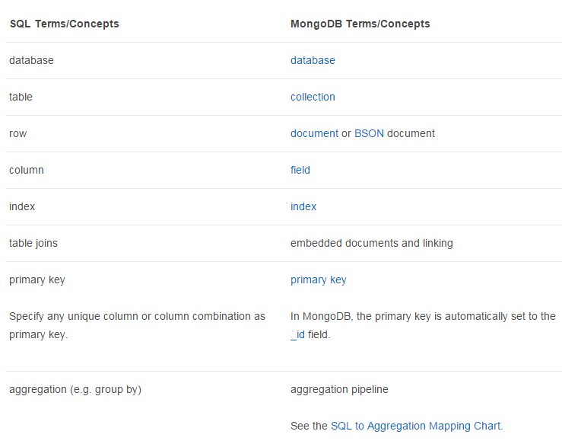

Slide 31
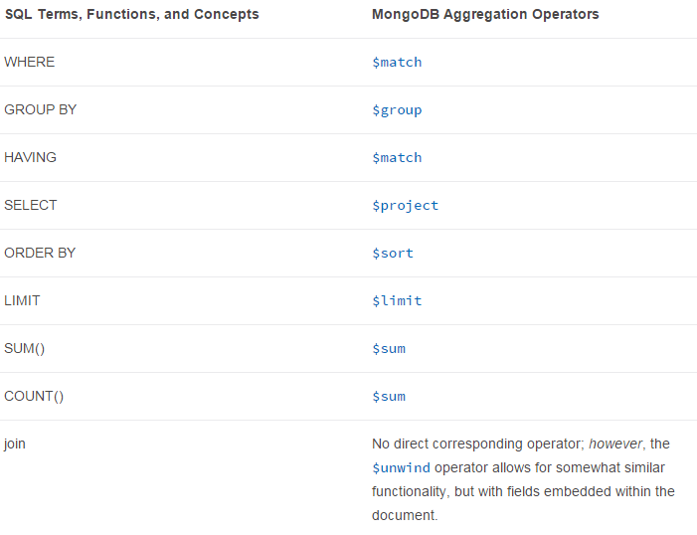

Slide 32
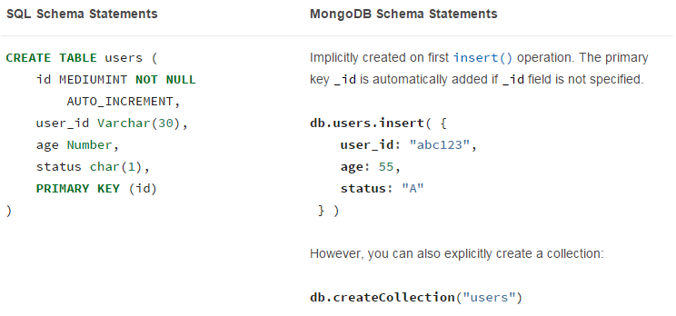
Creating Collections

Slide 33
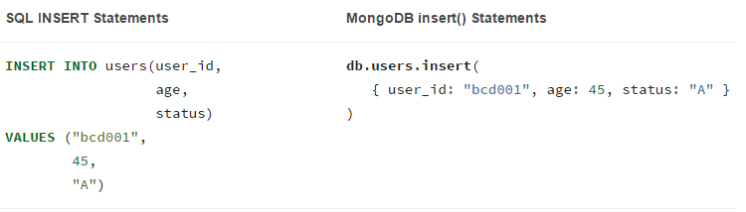
Insert

Slide 34
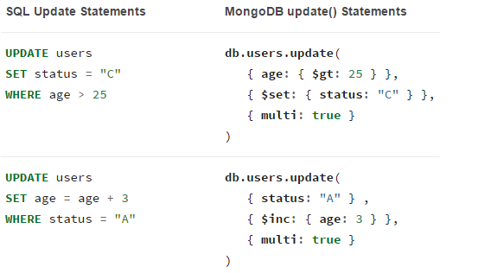
Update

Slide 35
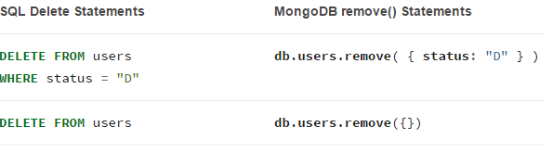
Delete

Slide 36
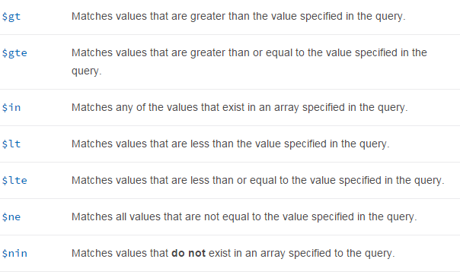
Logical and Comparison Queries

Slide 37
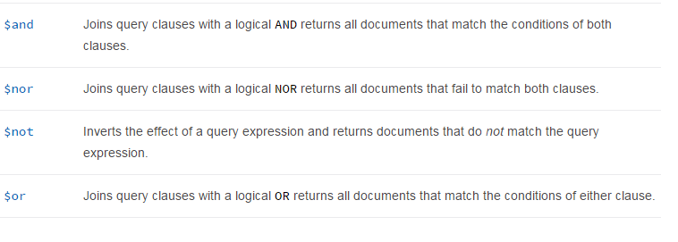
Logical and Comparison Queries

Slide 38
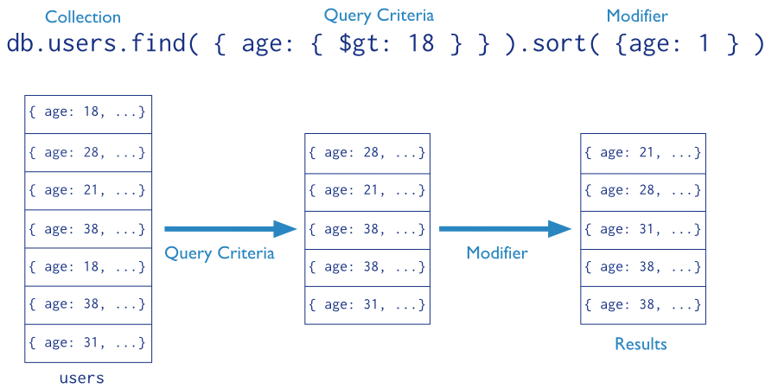
Query

Slide 39
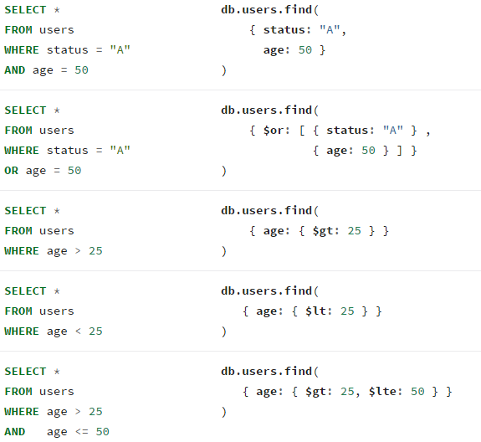

Slide 40

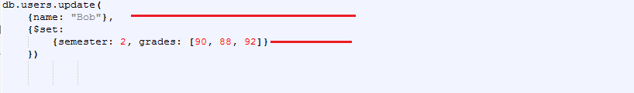
Examples
Adds an entry with fields name and semester. Because we don’t specify _id (primary key) it will be automatically created by DB.
Finds the first entry which matches this key-value (name -> “Bob”). Updates these fields if they exist or creates them if they don’t.

Slide 41


Examples
Finds the first entry which matches this key-value (name -> “Bob”). Removes this field if it exists or nothing otherwise.
Finds all the entries which matches this key-value (name -> “Bob”). Displays the _id (primary key) and grades fields.

Slide 42
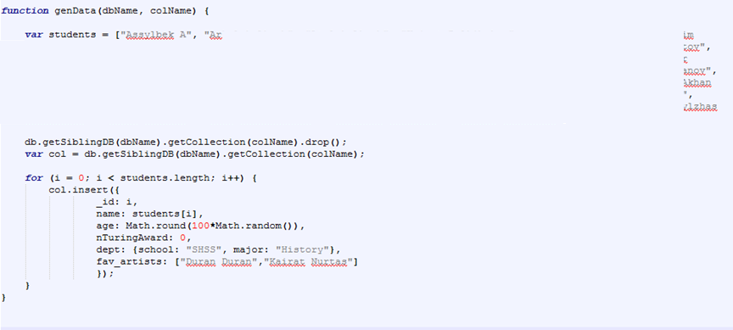
Javascript in MongoDB

Slide 43
Robomongo – MongoDB client
Runs on Windows
Download it here: http://www.dropbox.com/s/eyqcaqmulz5tlyx/Robomongo-0.8.4-i386.zip?dl=0
Unzip it and execute Robomongo.exe

Slide 44

Keep Security in Mind
SQL Injection https://www.owasp.org/index.php/SQL_Injection
NoSQL Injection https://www.owasp.org/index.php/Testing_for_NoSQL_injection
XML Parsing https://www.owasp.org/index.php/XML_External_Entity_%28XXE%29_Processing
JSON Arrays http://haacked.com/archive/2008/11/20/anatomy-of-a-subtle-json-vulnerability.aspx/

Slide 45
Works used
http://en.wikipedia.org
http://docs.mongodb.com
http://db-engines.com/en/ranking
http://queue.acm.org/detail.cfm?id=1563874
http://www.itnews.com.au/News/342615,inside-ebay8217s-90pb-data-warehouse.aspx
http://venublog.com/2012/11/30/typical-big-data-architecture/
http://www.statsoft.com/textbook/data-mining-techniques

